Slide 1

Analysis of Travel and Ratings
Group 3
Mark Mondville, Sai Nalluri, Anh Nguyen, Mary Thanam

Slide 2
Project Overview
634,277 original records, filtered to 617, 281
Ten full years of data, peaking in 2015
US Continental data for 752 hotels
Aspect star ratings from Giata, global provider of non-bookable travel content
Aspect star ratings change over time
TripCollective data generated from reviewer involvement

Slide 3
Data Resource
TripAdvisor Hotel Rating Dataset
Variables: Aspect Rating, Review’s title, Review’s Content, Check-in Time, Travel Type, Star Rating, Account Name, Travel Style, Total Points, Level, Badges, Address.

Slide 4
Dataset
Notes:
Briefly describe what includes in the dataset

Slide 5

Calculated Fields

Slide 6
Python Packages
Numpy
Array
Column Stack
Scikit-learn
Preprocessing
Label Encoder
Gaussian Naïve Bayes
Matplotlib
Plot

Slide 7
Research Questions
Does the travel type, time, or location influence reviewer rating?
Do aspect star ratings impact the travel type that stays at a location?
How accurate are aggregate aspect star ratings in predicting reviewer ratings?
Which aspect star ratings conform most closely to reviewer ratings?
Does key word analysis of reviews reveal correlations with aspect star ratings as compared to reviewer rating?
Do total points or level influence correspondence of aspect star ratings and reviewer ratings?

Slide 8
Question 1
How accurate are aspect star ratings in predicting reviewer ratings?

Slide 9
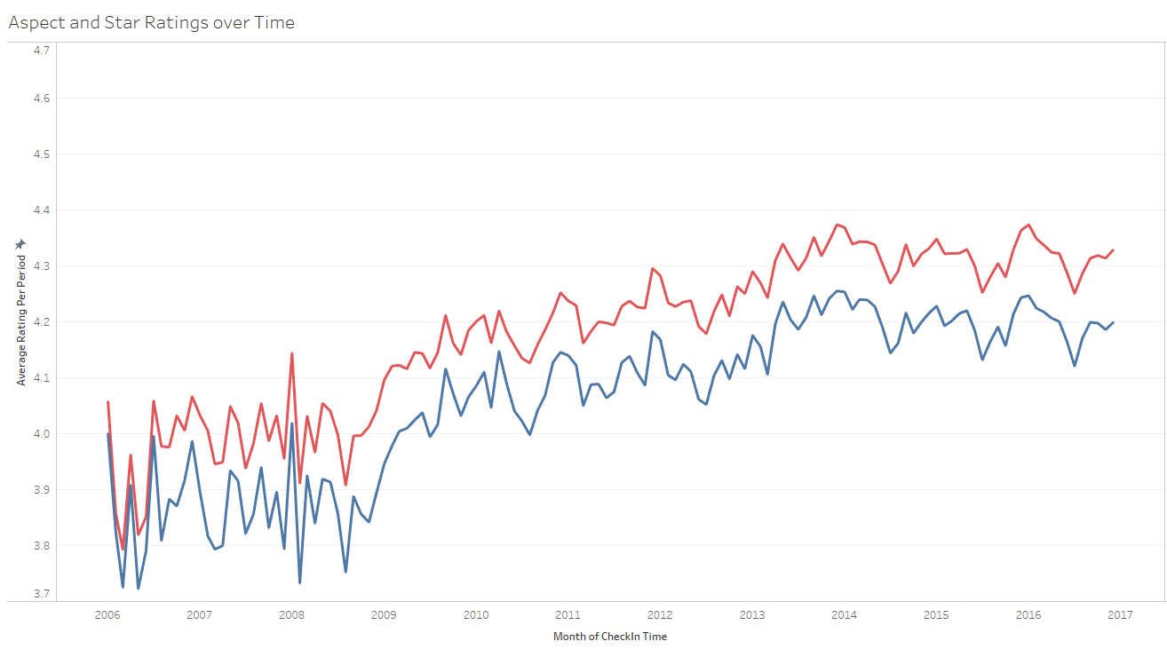


Slide 10
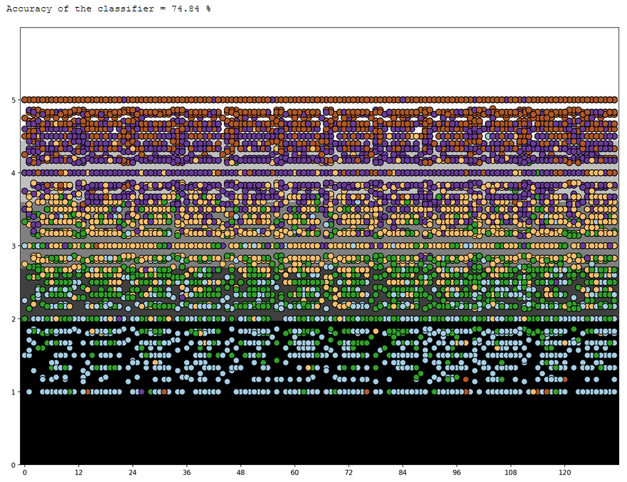

Slide 11
Question 2
How do individual aspect ratings compare and
do they show trends over time?

Slide 12
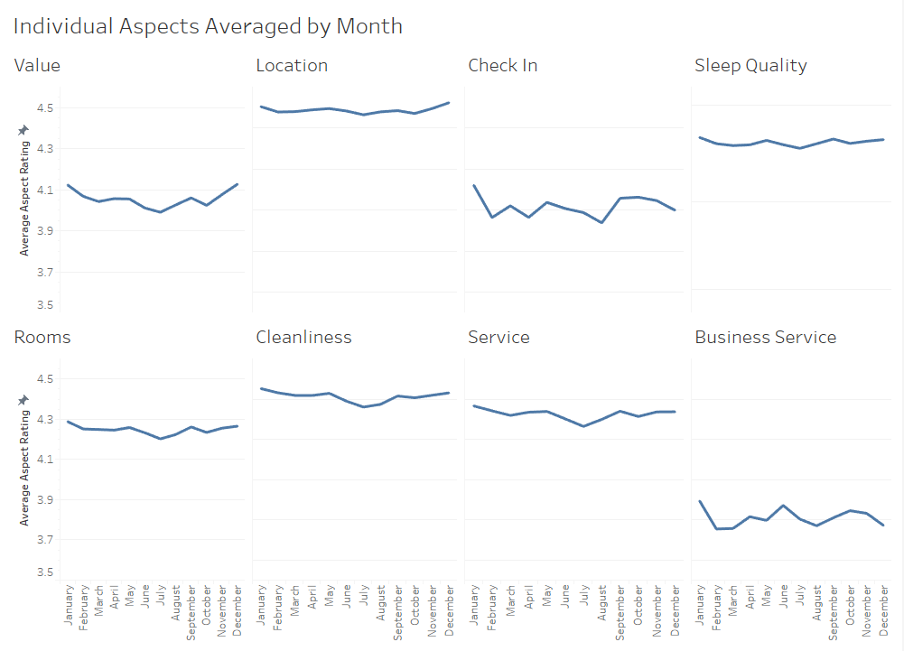

Slide 13
Question 3
Do the number of reviews reveal trends over time?

Slide 14
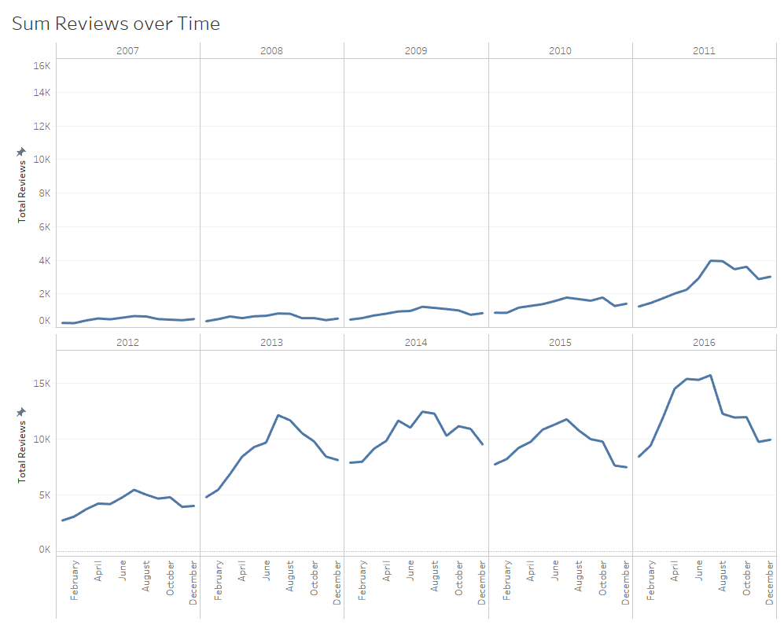

Slide 15
Question 4
Does the travel type reveal trends over time?

Slide 16
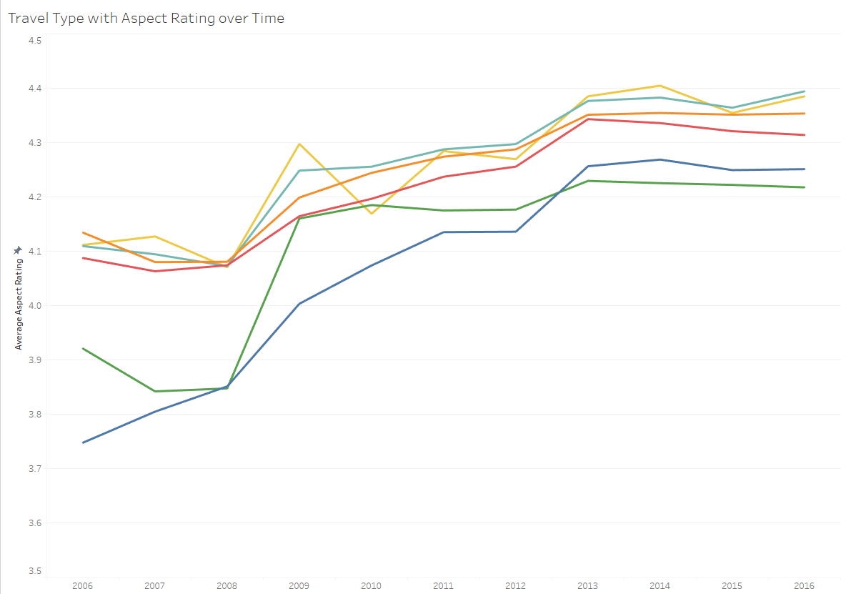
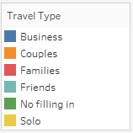

Slide 17
Question 5
Does TripCollective Level impact aspect ratings?

Slide 18
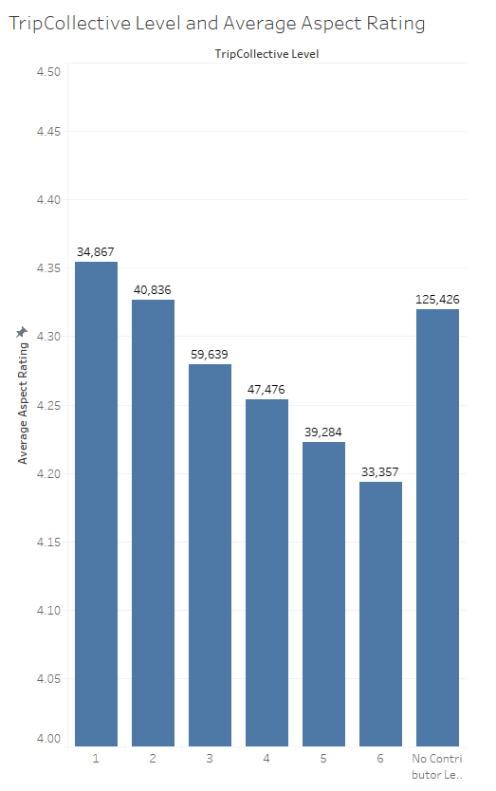
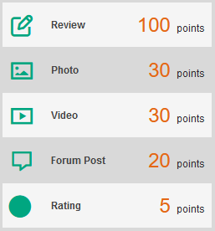
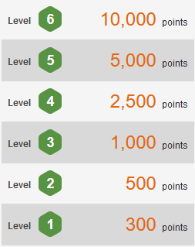

Slide 19
Question 6
How do states rank for total reviews
and aspect ratings?

Slide 20
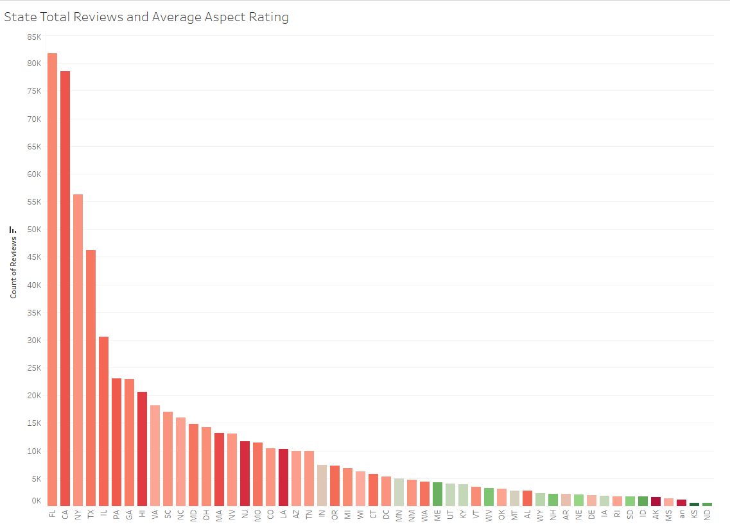


Slide 21
Question 7
Are aspect ratings affected by real world events?

Slide 22
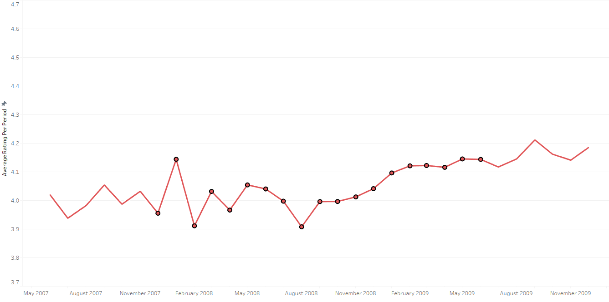

Slide 23
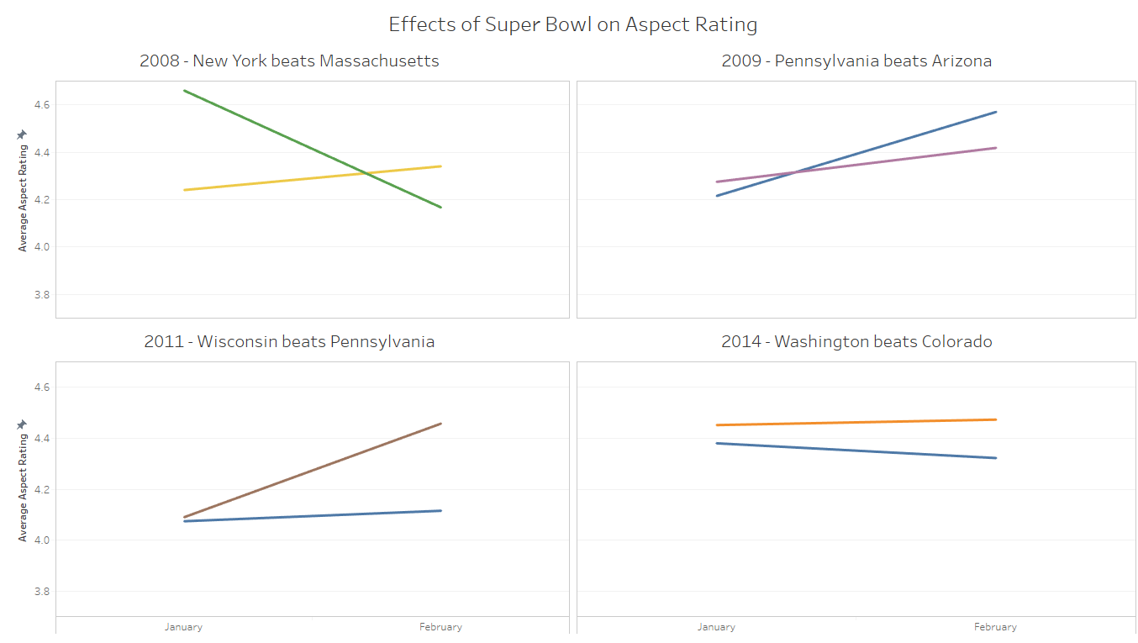
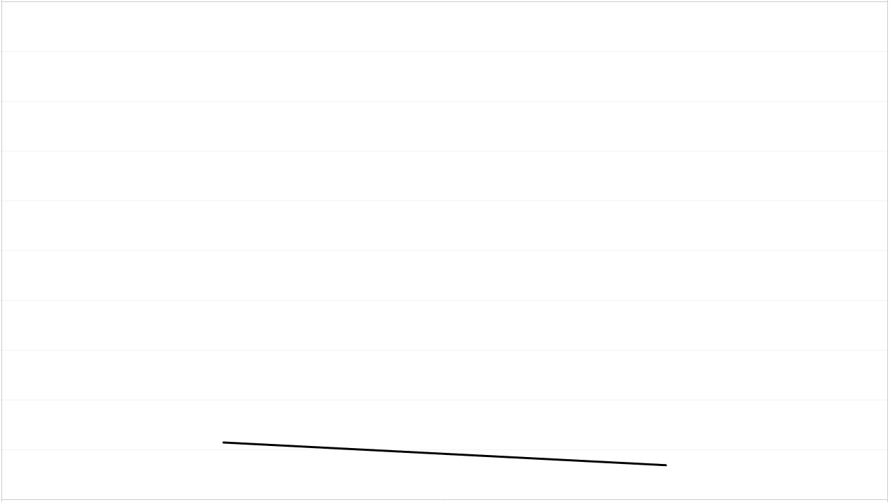
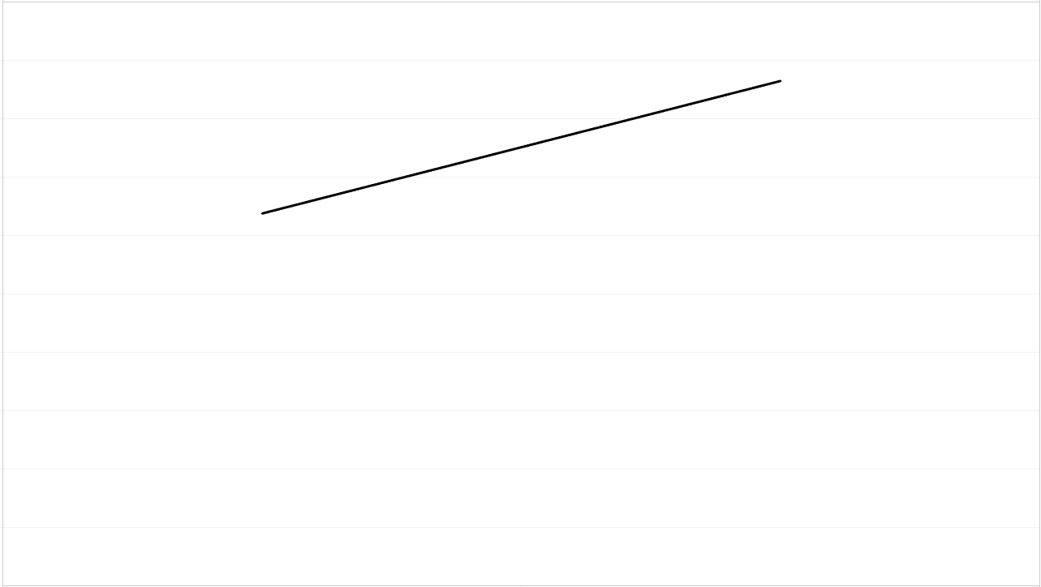


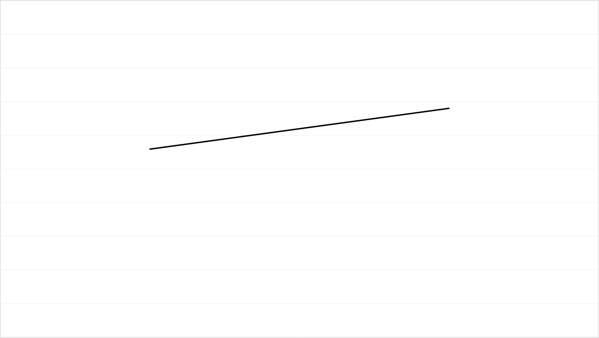
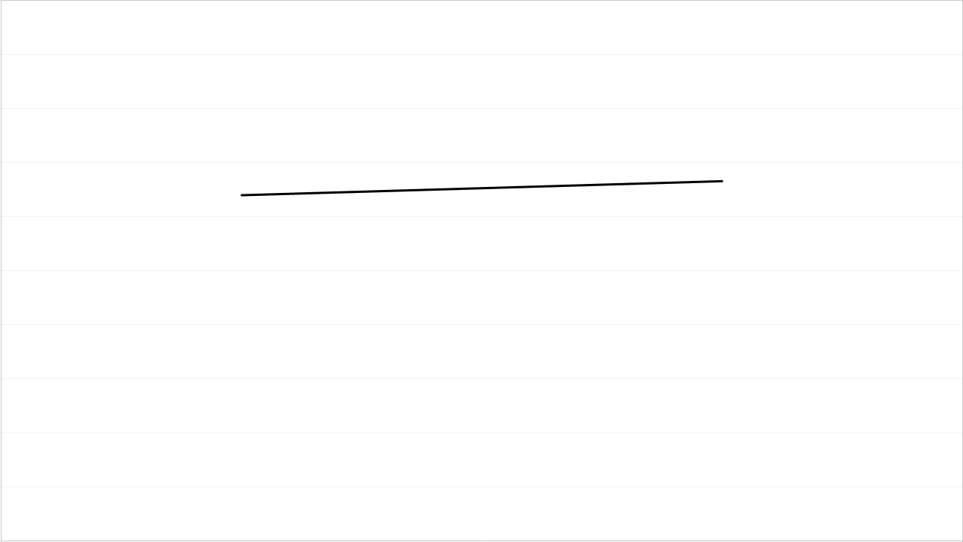



Slide 24
Thank you. Your Questions?
Group 3
Mark Mondville, Sai Nalluri, Anh Nguyen, Mary Thanam

